Slide 1

Lab 2
Group_D:
Laurice Sattouf
Choi Tim Anthony Young
Dimitri Garcia
Professor:
Mohamed El-Hadedy
California Polytechnic State University Pomona, California

Slide 2
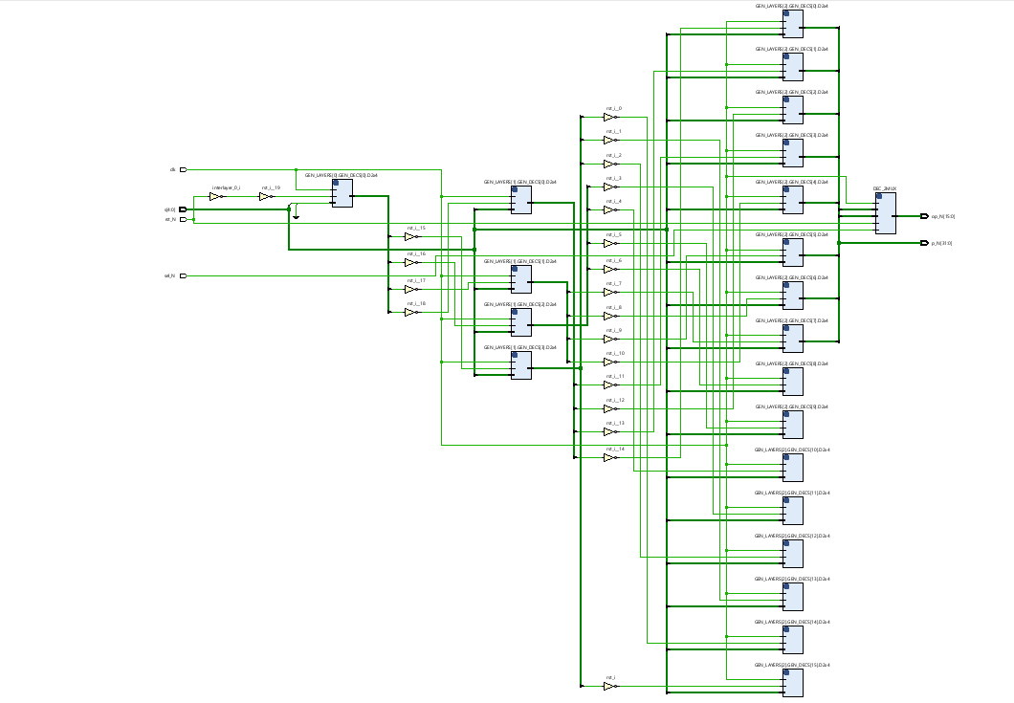
Assignment
Implementing Decoder Nx2^N using Generic, decoder 2x4 network ,and for loop in VHDL.
This figure is showing the circuit of the implemented design.

Slide 3
Coding Steps
Decoder2x4 entity created.
Decoder Nx2^N entity created. Using “generic “ allows us to change the size of the decoder to the desired value of N.
Using the “for generate” in the RTL allows to generate all the components needed.
In our code: we created 6x64 decoder for the purpose of getting the mission done, but the implementation is only 5x32

Slide 4
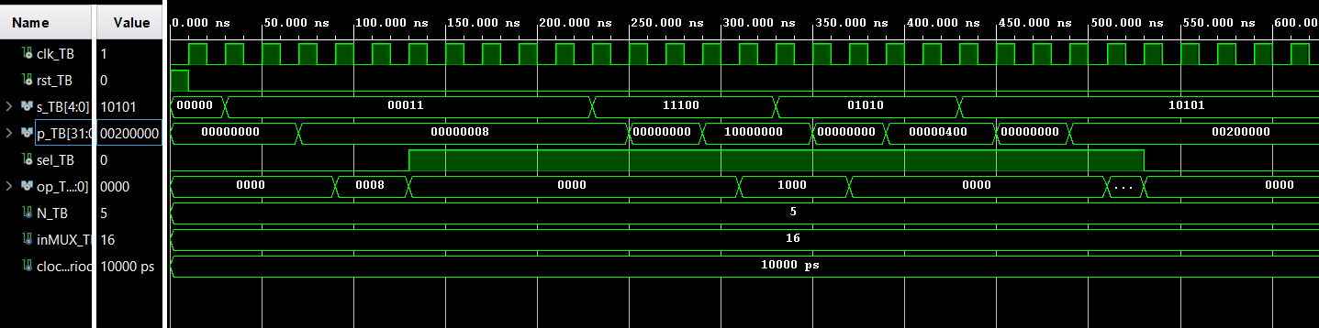
Test Bench Results:
Simulation from Vivado

Slide 5
Power and Resources

Slide 6

Work Distribution
We all worked individually on the code and then we had a discussion session to combine all the work.
Anthony mainly worked on the nested loop, the decoder layers fully, and the script for the input file.
Dimitri worked on connecting the Mux to the design, creating testbench.
Laurice did a different implementation to avoid creating extra Decoders in Anthony’s code, but it wasn’t successful. Plus, the textio file for testing.
We had a zoom meeting to demo and cover all missing areas
Documentation and reports were evenly distributed, and it covered all the steps of our successfully implemented design.

